Slide 1
Smarter Health Care Coalition 2022 Annual Virtual Policy Summit: Innovations in Benefit Design for Chronic Disease Management
In Partnership With
April 7th, 2022

Slide 2
Obesity and Mental Health: What’s the Connection?
Tiffani L. Bell Washington M.D. FAPA, D.ABOM, D.ABLM
Harvard T.H. Chan School of Public Health – Health Policy MPH Candidate ’22 The Healthy Weigh MD, PLLC Quadruple Board Certified Physician: Obesity Medicine Specialist General, Adult, and Child/Adolescent Psychiatrist Lifestyle Medicine Specialist
Disclaimer: Views are my own

Slide 3
This is mine
We all have a WHY…
We all have a WHY

Slide 4
Be like a flower. Survive the rain but use it to grow. – Anonymous.
“
“

Slide 5
2013
Medical News Today: AMA 2013

Slide 6
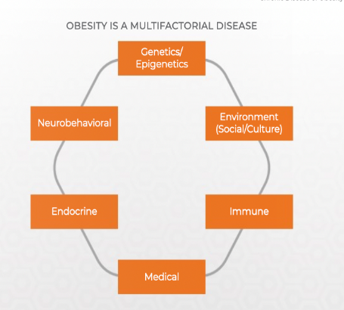
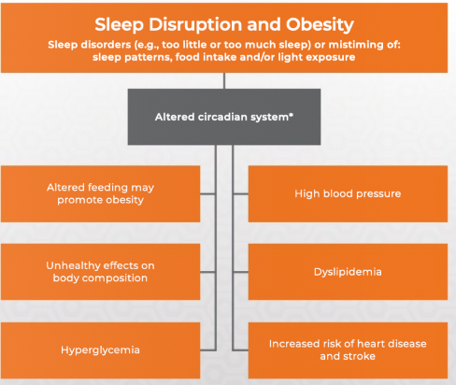
Obesity is a Disease
Obesity Medicine Association

Slide 7
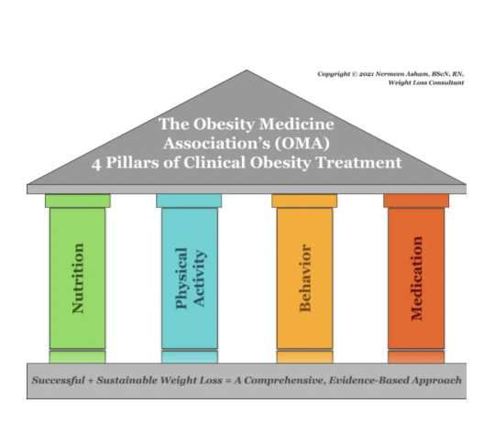
A Few Key Points On Obesity
Not a bad word, not a label… just a medical diagnosis, for a DISEASE.
MUST LIMIT LABELING OF PATIENTS (We are not our diagnoses!)
Many causes: Medications, increased hunger hormones, increased stress, genetics, built environment, depression, poor food choices, issues with sleep, limited time to make healthy meals, policies in place that promote weight gaining environments, poor health/mobility, and more.
Multidisciplinary teams are often beneficial. Treatment should focus on several ”pillars” at one time, not just “eat less and move more"
Pillars include, Behavior, Physical Activity, Nutrition, Medication
Obesity Algorithm®. © 2021 Obesity Medicine Association section

Slide 8
Adverse Childhood Experiences →
Mental Health Disorders
Weight Concerns and Obesity
Just ONE caring adult can help counter some of these adverse experiences*
Fischer et All

Slide 9
Stress + Mental Health
Top 10 Takeaway Messages: Obesity and Stress
Shorter-term “fight or flight” stress response increases stress hormones Usually improves cognition, physiologic function, tolerance to pain, and immune function - When short-term If long-term, “submit and stay” stress may increase hypothalamic corticotropic activity and worsen sleep patterns Longer-term hypothalamic stress responses may increase food craving, increase blood pressure, worsen glucose metabolism, promote pain intolerance, and dysregulate immune responses Chronic stress-induced adiposopathic responses may adversely affect the limbic system Dysregulation of the limbic system with chronic stress may affect hunger, food choice, and emotional modulation of food intake Dysregulation of the limbic system with chronic stress may affect reward-seeking behavior Mental stress may affect the cerebrum, which may contribute to prioritization of personal, work, or other behaviors and activities, with less prioritization of healthful behaviors and activities (i.e., healthful nutrition and regular physical activity) Mental stress may impair self-regulation and promote choosing unhealthful (immediately rewarding ultra-processed) foods over more healthful (delayed-gratification unprocessed) foods Obesity and its adverse health complications may increase mental stress, which may contribute to unhealthful behavior, endocrinopathies and immunopathies, which in turn, may further worsen obesity and its complications, resulting in an adiposopathic stress cycle.
Increased stress → increased cortisol → weight gain (and some MH disorders)
Obesity Algorithm®. © 2021 Obesity Medicine Association section

Slide 10
Obesity Mental Health
Obesity and mood disorders frequently occur together
The relationship between obesity and depression is bidirectional. Obesity is a risk factor for mood disorders; mood disorders are a risk factor for obesity.
The association between depression and obesity may be stronger among women
Obesity and psychiatric diseases may share pathogenic pathways
Psychiatric diseases can sometimes independently contribute to overnutrition and/or consumption of foods rich in carbohydrates and fats
Some people gain body weight in response to medications used to treat mental health disorders
Obesity Algorithm®. © 2021 Obesity Medicine Association section
Notes:
involving the immune and endocrine system, hypothalamic and pituitary axis, and nervous system (e.g., autonomic nervous system, monoamines, synapses, neurogenesis, and neuroinflammation)

Slide 11
We are like snowflakes, all different in our own beautiful way.
“
We are like snowflakes, all different in our own beautiful way.

Slide 12
References:
Kyler KE, Hall M, Halvorson EE, Davis AM. Associations between Obesity and Adverse Childhood Experiences in the United States. Child Obes. 2021 Jul;17(5):342-348. doi: 10.1089/chi.2020.0261. Epub 2021 Apr 20. PMID: 33877887.
Wiss DA, Brewerton TD. Adverse Childhood Experiences and Adult Obesity: A Systematic Review of Plausible Mechanisms and Meta-Analysis of Cross-Sectional Studies. Physiol Behav. 2020 Sep 1;223:112964. doi: 10.1016/j.physbeh.2020.112964. Epub 2020 May 29. PMID: 32479804.
Merrick MT, Ports KA, Ford DC, Afifi TO, Gershoff ET, Grogan-Kaylor A. Unpacking the impact of adverse childhood experiences on adult mental health. Child Abuse Negl. 2017 Jul;69:10-19. doi: 10.1016/j.chiabu.2017.03.016. Epub 2017 Apr 15. PMID: 28419887; PMCID: PMC6007802.
DoctorPrimack. (2021, April 28). Presentation: the medical science of obesity (treat weight or refer to someone who does). OMA Spring Presidential Address. Retrieved from https://www.youtube.com/watch?v=Z-qh4zMhddQ
Greger, M. (2019). How not to diet. (1st edition).New York, NY: Flatiron Books
Ziltzer, R. & Primack, C. (2019) Chasing diets: stop the endless search and discover the solution. Dublin, OH: Telemachus Press, LLC
Medical News Today: AMA 2013
Fisher PA, Gunnar MR, Dozier M, Bruce J, Pears KC. Effects of therapeutic interventions for foster children on behavioral problems, caregiver attachment, and stress regulatory neural systems. Ann N Y Acad Sci. 2006 Dec;1094:215-25. doi: 10.1196/annals.1376.023. PMID: 17347353.

Slide 13
Understanding Obesity: A Lived Experience-Centric View Joe Nadglowski President/CEO Obesity Action Coalition

Slide 14
Notes:
Here is our problem…. The obesity rates when last measured were 42% of US adults and almost 10% had BMI >40 which is a qualification for bariatric surgery. What are we to do???

Slide 15
The Truth is that Obesity Is a Highly Heritable Chronic Disease
• Heredity plays a dominant role in obesity risk
• But environmental factors serve to activate it
• Then, people can choose what to do about it
Personal Choices
Environmental Triggers
Heritability 70%
Source: Musani, Erickson, and Allison, AJCN, 2008; “Obesity – Still Highly Heritable After All These Years”

Slide 16
In Fact, Multiple Factors are Driving Obesity Rates

Slide 17
Economics of Obesity
The cost of chronic disease attributed to the prevalence of obesity and being overweight are estimated at $1.72 trillion, equivalent to 9.3% GDP.
Obesity is considered the greatest contributor to the burden of chronic disease accounting for 47.1% of the total cost of chronic disease.
Healthcare costs for people with obesity are about 42% higher than for unaffected adults with most of those costs associated with severe obesity (BMI over 40).
Milken Institute (2018), “America's Obesity Crisis: The Health and Economic Costs of Excess Weight.”

Slide 18
Good Obesity Care Requires Access to the Full Range of Obesity Care Tools
Self-Care
Professional Lifestyle Therapy
Pharmacotherapy + Lifestyle Therapy
Surgical Care
Post Surgery Care

Slide 19
Good Obesity Care Requires Recognition that:
Treatments fail people, people don’t fail treatments
Not all treatments work for all people. Treatment response varies by individual.
Just because you start with one treatment doesn’t mean it will be effective for a lifetime.
Social and economic barriers play a significant role.
Treating Obesity is hard! We don’t have solutions for everyone.

Slide 20
Modest Weight Loss Has Benefits— Greater Weight Loss Is Associated With Greater Benefits
Measures of glycemia¹
Triglycerides and HDL cholesterol¹
Systolic and diastolic blood pressure¹
Progression from prediabetes to diabetes¹
Hepatic steatosis (measured by MRS)²
Measures of feeling and function
Symptoms of urinary stress incontinence¹
Measures of sexual function³
Quality of life measures (IWQOL)⁴
NASH activity score (measured by biopsy)¹
Apnea-hypopnea index¹
Reduction in CV events, mortality, remission of T2DM^{5,6}
−3.0%
−5.0%
−10.0%
−15.0%
−20.0%
−25.0%
1. Cefalu WT, et al. Diabetes Care. 2015;38:1567-1582; 2. Lazo M, et al. Diabetes Care. 2010;33:2156-2163.
3. Wing R, et al. Diabetes Care. 2013;36:2937-2944; 4. Kolotkin RL, et al. Obes Res. 2001;9:564-571.
5. Sjostrom L, et al. JAMA. 2012;307:56-65; 6. Sjostrom L, et al. JAMA. 2014;311:2297-2304.
Notes:
FXCX helps:
In general, looking for greater weight loss providing greater benefit for a given complication OR greater degree of weight loss needed for improvement in the complication.
Have not confirmed references 2-6…but some are also listed in the slides for 4410607 (2015 MEDS program), so that may provide some guidance.
All for Cefalu (ref 1) – Table 1
Diabetes prevention: 3 to 10%
Glycemia: 3 to > 15%
Diabetes prevention
A1C/lipids 3 to > 15%
HTN 5 to > 15
Hepatic steatosis/NASH/NAFLD 10%
Sleep apnea 10%
I think Kolotkin and Samsa abstracts will confirm association between degree of weight loss and amount of improvement in QoL.
Cited Sjostrom/SOS references to support greater reduction in CV events, mortality, remission of T2DM with greater weight loss BUT 2 of the 3 specifically state that the studies are not powered to demonstrate the effect of weight loss – just the effect of surgery vs no surgery…I have been able to find data supporting intent to lose weight and mortality benefits, but not amount of weight loss (eg: http://care.diabetesjournals.org/content/diacare/27/3/657.full.pdf)
Kim had a much longer list of citations. I took the more current ones and omitted the others. If we can support the info without the full list, that would be my preference but in case you need other refs to support what is here, this is the full list:
1. Cefalu WT, et al. Diabetes Care. 2015;38:1567-1582.
2. Wing RR, et al. Diabetes Care. 2011;34:1481-1486.
3. Lazo M, et al. Diabetes Care. 2010;33:2158-2163.
4. Phelan S, et al. J Urol. 2012;187:939-944.
5. Wing R, et al. Diab Care. 2013;36:2937-2944.
6. Wing R, et al. J Sex Med. 2010;7:156-165.
7. Kolotkin RL, et al. Obes Res. 2001;9:564-571.

Slide 21
Access to Obesity Care Varies Widely
Obesity Coverage Under the Affordable Care Act
Source: ASMBS Access to Care Toolkit www.asmbs.org

Slide 22
Let’s agree to a shared understanding…
Obesity is a chronic disease, with a powerful biologic basis.
Evidence-based treatments can produce and sustain weight loss and can reverse and remediate other chronic diseases.
Obesity care is often exists in silos.
Barriers to obesity care are significant.
Notes:
We begin with a shared understanding that … (read slide)

Slide 24
Notes:
What do you think this doctor and woman are discussing? Is it about her weight? If so, is it a positive comment?
Implicit Bias Data

Slide 25
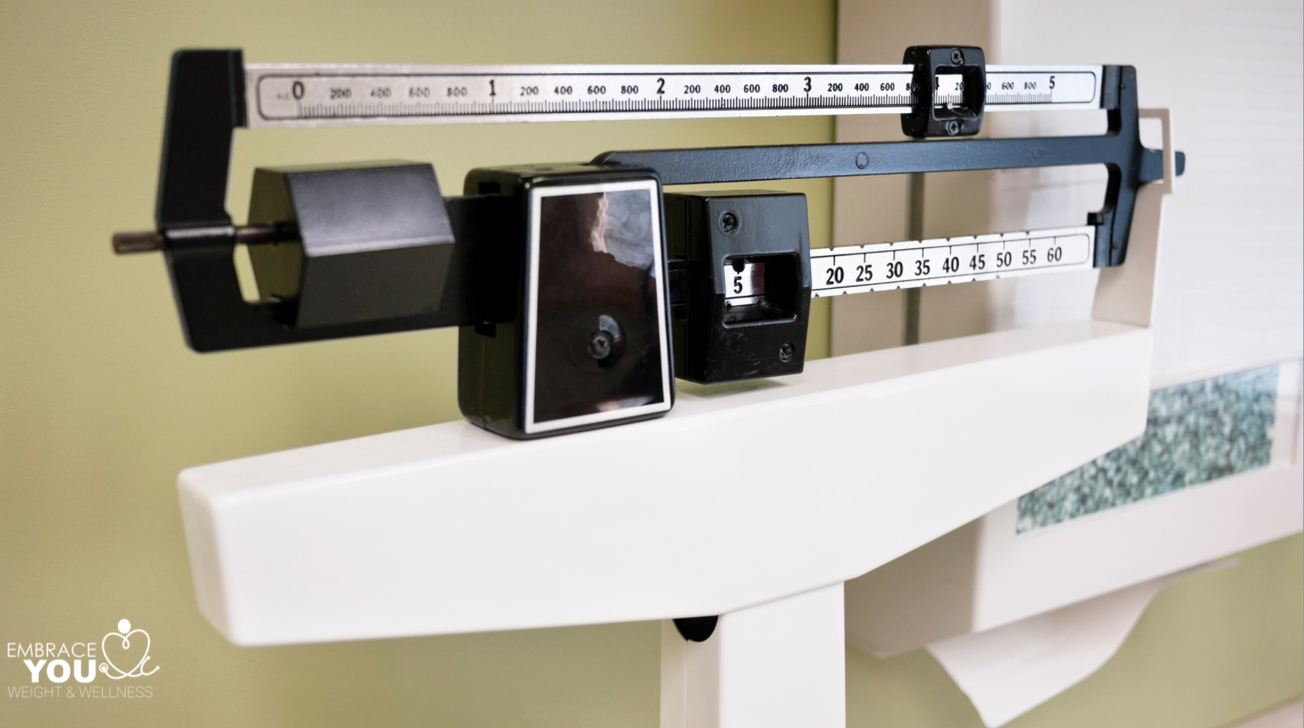
Sources of Weight Bias
DOCTORS
69%
Women
Experienced
Weight Bias
NURSES
31%
Prefer not
To work with
Patients with Obesity
HEALTHCARE
LOWER PAY
Than
Thinner Colleagues
NEGATIVE PERFORMANCE
Evaluations
WORKPLACE
MEDIA
SOCIAL
ACADEMICS
FAMILY
Notes:
There are various sources of weight bias. It’s second only to racial bias. And cited by many sources as the only form of “acceptable discrimination”

Slide 26
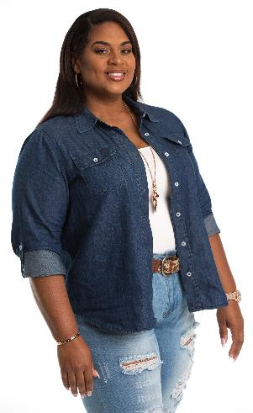
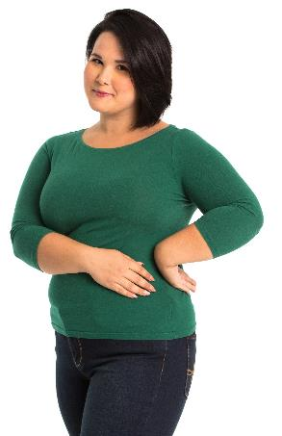
Body Mass Index (BMI) & Bias
Origin of BMI
Body Composition Differences
Muscle mass
Fat distribution
Age also impacts Body Composition
Genetic Differences
BDNF
SEMADF
Overestimation of Obesity with Traditional BMI threshold
Notes:
Origin 1832 Quelet; 1972 Keys. Made for population based data. Original norms based on Caucasians. Racial differences in body composition impact use of BMI.
. There have been racial differences noted in the use of BMI. Specifically for African Americans BMI tends to over-estimate being overweight between a BMI of 25- 29.9 kg/ m2 due to higher levels of lean muscle Harvard T.H. Chan School of Public Health (2020, July 4) Obesity Prevention Source: Obesity Definition https://www.hsph.harvard.edu/obesity-prevention-source/obesity-definition/how-to-measure-body-fatness/
mass in African Americans. Also there has been conflicting data with some studies showing that, compared to normal BMI (18.0-24.9 kg/m2), people who are overweight (BMI 25-29.9kg/m2) have a lower all-cause mortality. Moreover grade 1 obesity (BMI 30-35 kg/m2) may not be associated with higher mortality. Whereas more recent studies have shown that even at a non-obesity BMI or “healthy” BMI 18- 24.9kg/m2, African Americans have higher levels of “obesity related” disease such as type 2 diabetes, hypertension and heart disease. Critics point to this discordance in BMI data as evidence of the racial bias in using BMI as a measurement tool. Flegal, K et. Al (2013). “Association of All Cause Mortality with Overweight and Obesity Using Standard Body Mass Index Categories: A Systemic Review and Metaanalysis” Journal of the American Medical Association 309, 1:71-82.
Firjer, J (2017, May 7). There’s Dangerous Racial Bias in BMI. Newsweek. https://www.newsweek.com/2017/05/19/obesity-childhood-obesity-body-mass-index-bmi-weight-weight-gain-health-595625.html
Genetic differences: ”A specific pathway where racial differences in hormone production have been discovered is in the production of brain-derived neurotrophic factor (BDNF). hen G recently found further evidence that points to the role genes may play in differences in obesity prevalence based on race/ethnicity. Their group evaluated samples from 1411 West Africans as well as samples from 9020 African Americans and found that samples from participants with obesity had higher levels of protein SEMA4D in serum samples and that elevated levels of serum SEMA4D were associated with a much higher risk for obesity [28••]. The group also found that carriers of the SEMA4D C allele were 4.6 BMI units heavier than those with the T allele [28••], and it is notable that among people of European and Asian descent, the SEMA4D protein is mono-morphic for the Tallele which highlights the importance genes may play in obesity prevalence”
Byrd, A. S., Toth, A. T., & Stanford, F. C. (2018). Racial Disparities in Obesity Treatment. Current obesity reports, 7(2), 130–138. https://doi.org/10.1007/s13679-018-0301-3

Slide 27
Obesity Treatment & Bias
Notes:
Imagine you’re the starter, the person who calls the race, it's time to start the race. Just as you are about start the race all the runners are in position when all of a suddenyou notice 1 runner is missing finally they appear short of breath wheezing so loudly you can hear them. They have asthma. Do you give them medication? Or say suck it up and run the race. Exercise is good for your lungs. Because of our scientific understanding of asthma and social acceptance of asthma we’d show compassion to this runner and give them the treatment they need. Now let’s consider a different type of race.

Slide 28
Notes:
“Race” to optimal health with obesityn

Slide 29
Addressing Weight Bias
Awareness
Your Personal Bias
Impact of Systemic Bias
Take Action

