Slide 1
Smarter Health Care Coalition 2022 Annual Virtual Policy Summit: Innovations in Benefit Design for Chronic Disease Management
In Partnership With
April 7th, 2022

Slide 2
HSA-Eligible Health Plans Embrace Changes to Better Serve Americans With Chronic Health Conditions
April 7, 2022
1

Slide 3
Employers and Health Insurance Providers Addressing Chronic Conditions in America
More than 32 million Americans have employer-provided coverage that, when combined with a health
savings account (HSA), provides them with more control over and value for their health care.
In July 2019, the Internal Revenue Service (IRS) issued Notice 2019-45, guidance which expanded the list
of preventive care benefits to include many items and services used to manage chronic health conditions.
In May - June 2021 AHIP and the Smarter Health Care Coalition conducted a survey of health insurance plans to assess changes in the benefit design for HSA-eligible HDHPs. Thirty-six health plans covering every region of the country responded to the survey.
2

Slide 4
Key Takeaways
Most HSA-eligible health plans are leveraging new regulatory flexibility to cover more chronic disease prevention services on a pre-deductible basis.
Diabetes and heart disease are the two most commonly targeted conditions for reducing or eliminating cost sharing.
Reduced or eliminated cost sharing for chronic disease prevention drugs and services is not resulting in a significant increase in premiums.
3

Slide 5
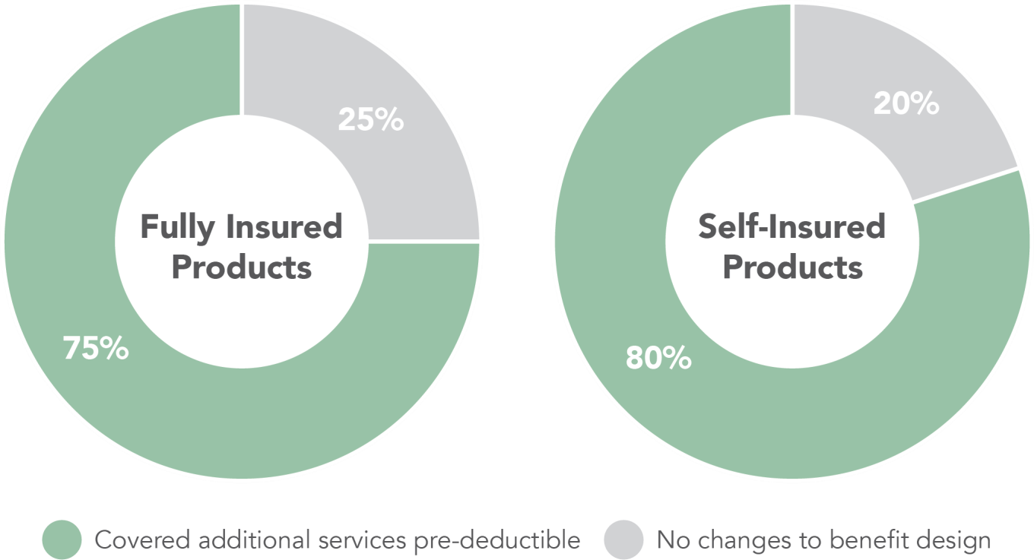
Most responding health insurance providers leveraged new flexibilities to cover new chronic disease prevention services pre-deductible in HSA-eligible Health Plans
4

Slide 6
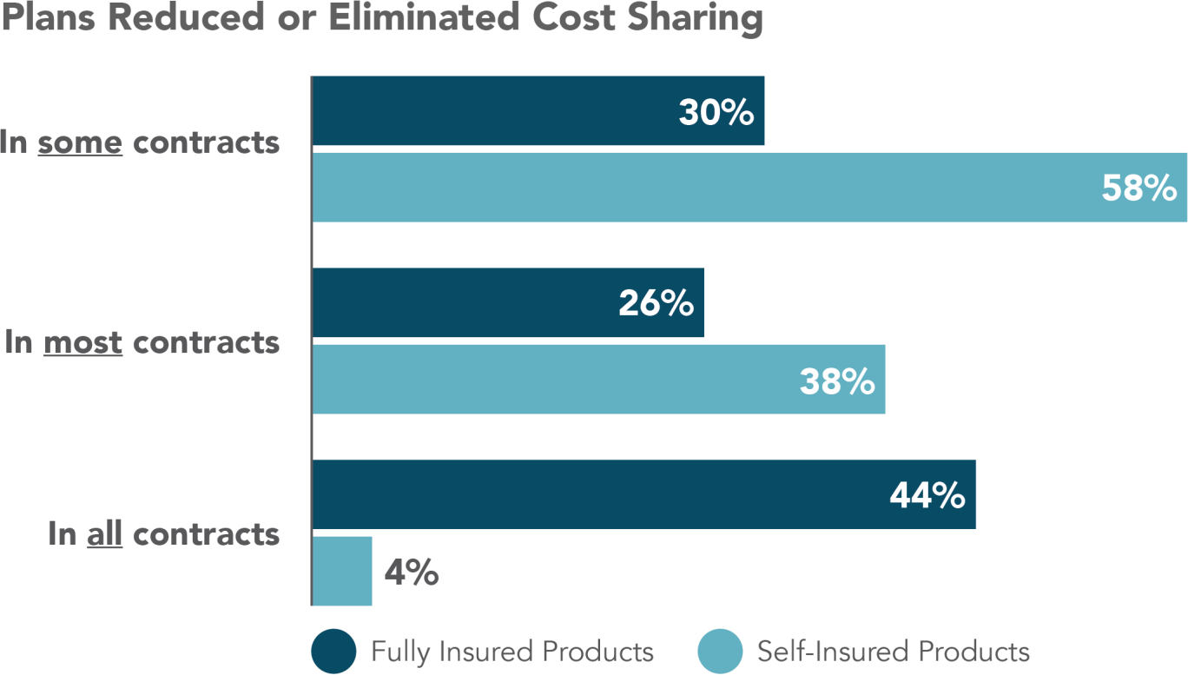
Most responding health insurance providers leveraged new flexibilities to cover new chronic disease prevention services pre-deductible in HSA-eligible Health Plans
5

Slide 7
Chronic Conditions Targeted in Fully Insured Plans
 | In some fully insured products | In most fully insured products | In all fully insured products | Not targeted
Asthma | 19% | 15% | 19% | 46%
Bleeding disorders | 8% | 12% | 19% | 62%
Congestive heart failure | 23% | 23% | 12% | 42%
Coronary artery disease | 23% | 19% | 15% | 42%
Depression | 15% | 19% | 15% | 50%
Diabetes | 23% | 31% | 42% | 4%
Heart disease | 23% | 27% | 23% | 27%
Hypertension | 23% | 27% | 15% | 35%
Liver disease | 8% | 8% | 19% | 65%
Osteoporosis | 12% | 15% | 8% | 65%
Other (please describe) | 12% | 4% | 12% | 73%
6

Slide 8
Chronic Conditions Targeted in Self-Insured Plans
 | In some self-insured products | In most self-insured products | In all self-insured products | Not targeted
Asthma | 30% | 26% | 4% | 39%
Bleeding disorders | 13% | 17% | 9% | 61%
Congestive heart failure | 39% | 17% | 4% | 39%
Coronary artery disease | 39% | 22% | 4% | 35%
Depression | 39% | 9% | 9% | 43%
Diabetes | 57% | 30% | 9% | 4%
Heart disease | 39% | 26% | 9% | 26%
Hypertension | 39% | 22% | 4% | 35%
Liver disease | 13% | 17% | 9% | 61%
Osteoporosis | 30% | 9% | 4% | 57%
Other (please describe) | 9% | 4% | 9% | 78%
7

Slide 9
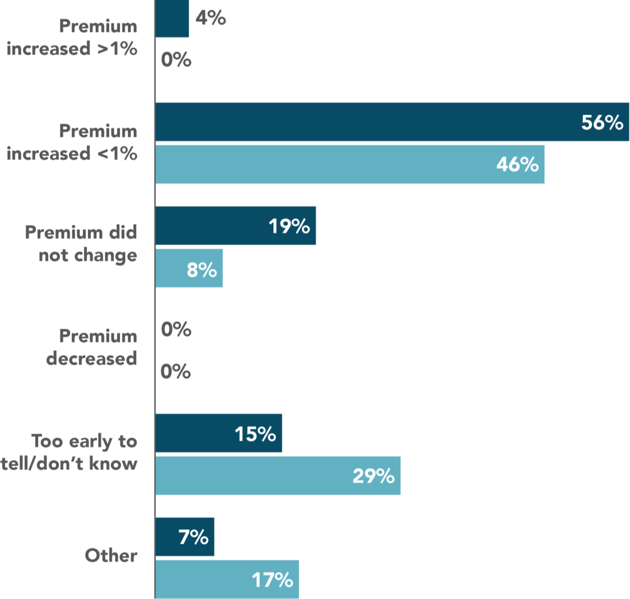
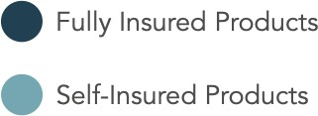
Reducing or eliminating cost-sharing for chronic disease prevention drugs and services did not result in significant premium increases
8

Slide 10
Pre-Deductible Coverage Of Additional Services To Most Likely Improve Patient Satisfaction
Services | %
Primary care office visits | 81%
Permanent ability to offer telehealth services pre-deductible | 64%
Coverage of mental and behavioral health services | 53%
Visits to specialists to manage chronic conditions | 44%
Coverage for additional drugs or services used to treat chronic conditions not included in Notice 2019-45 issued by the IRS in 2019 | 42%
Permanent ability to offer testing, treatment, or vaccinations pre-deductible in response to public health emergencies | 33%
Visits to on-site medical clinics | 22%
Other | 25%
9

Slide 11
Employer Uptake of Pre-Deductible Coverage for Preventive Services in HSA-Eligible Health Plans
Paul Fronstin, Ph.D.
Employee Benefit Research Institute

Slide 12
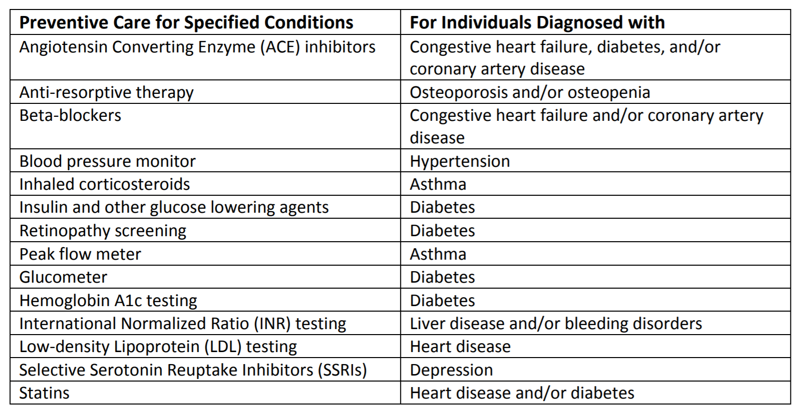
List of Services and Drugs for Certain Chronic Conditions Classified as Preventive Care Under Notice 2019-45

Slide 13
What Happened Since 2019?
By the time 2019 guidance came out, likely too late for many employers to add coverage for 2020.
Kaiser Family Foundation found that 29% had added coverage in 2020.
Goals of EBRI survey:
To provide more recent data – 2021 – after employers had more time to respond to the rule.
To provide more granularity around the 14 services
To examine cost sharing for additional pre-deductible coverage

Slide 14
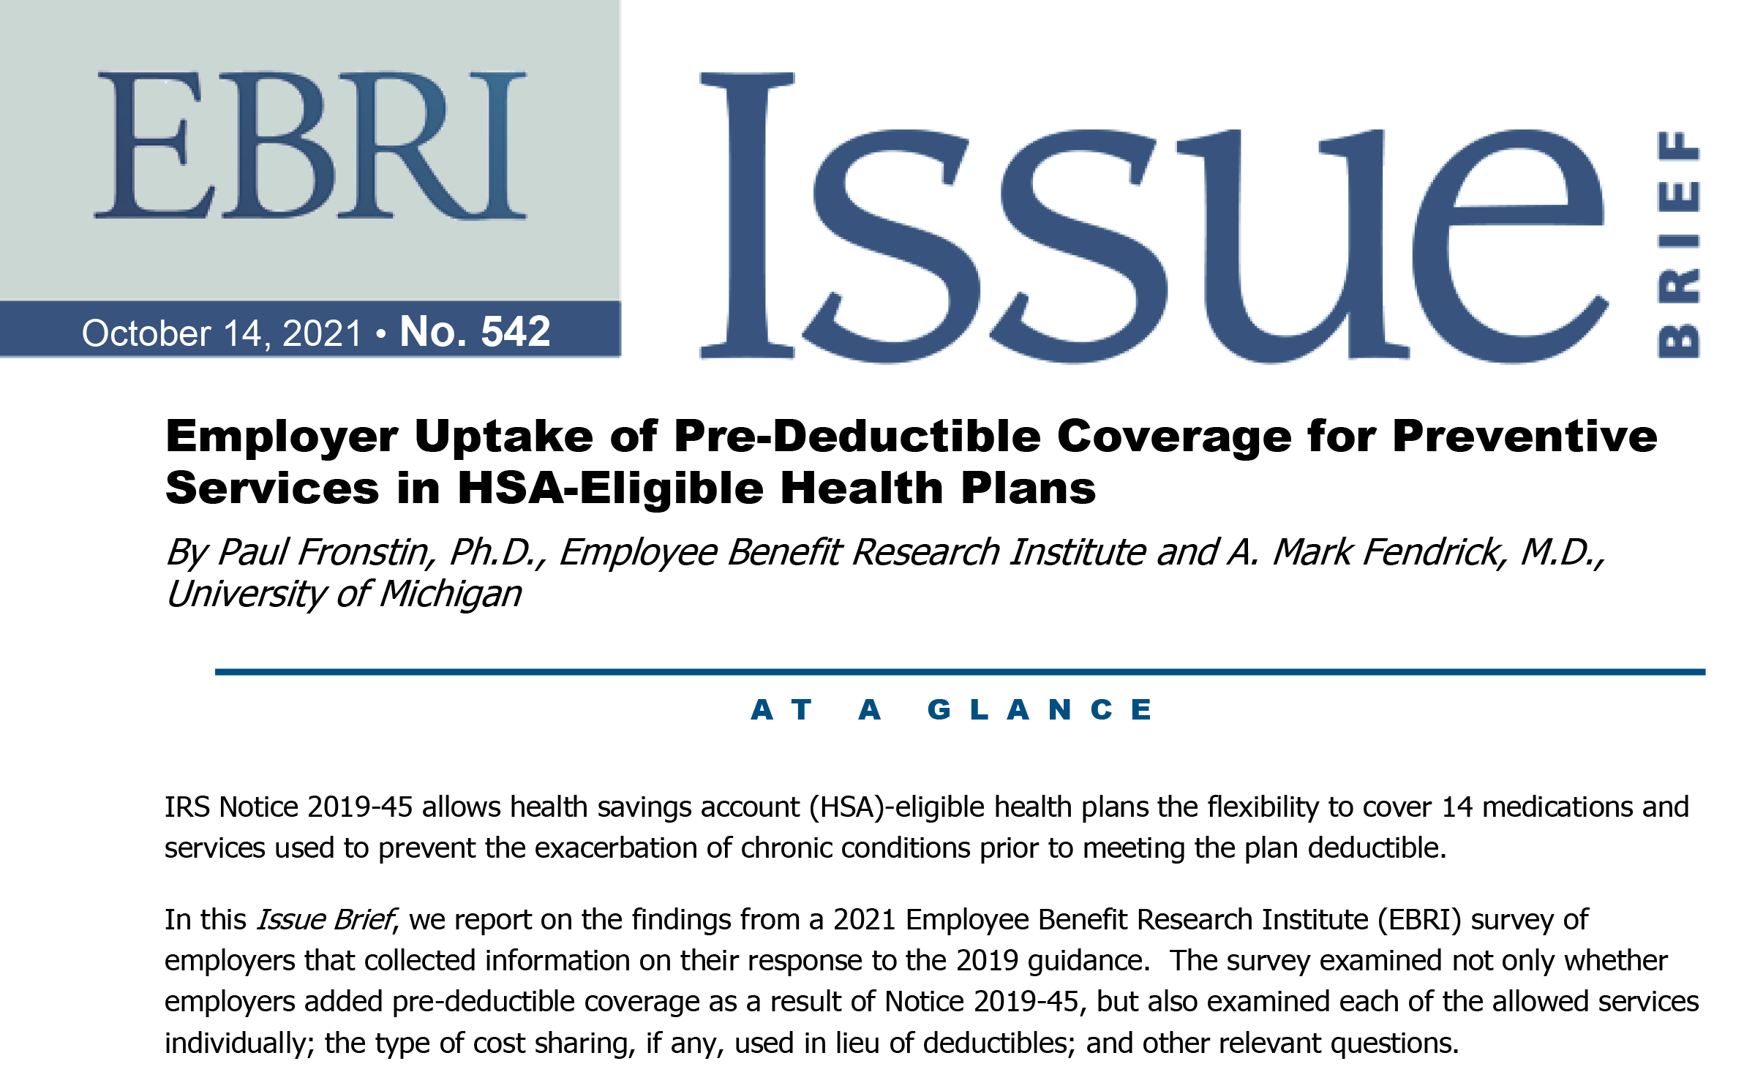

Slide 15
Percentage of Employers Who Expanded Pre-Deductible Coverage in HSA-Eligible Health Plan for Preventive Services Allowed Under IRS Rule 2019-45

Slide 16
Preventive Care Measures Covered on a Pre-Deductible Basis as a Result of IRS Notice 2019-45

Slide 17
Cost Sharing Arrangement as a Result of IRS Rule 2019-45

Slide 18
Additional Pre-Deductible Coverage that Employers Would Like to Add (Based on Open Ended Question)

Slide 19
Plans to Add Pre-Deductible Preventive Coverage, Among Employers Who Have Not Added Such Coverage

Slide 20
Expanding Access to Chronic Disease Prevention
Jackie Le Grand, Manager Health Policy
April 7, 2022

Slide 21
About JDRF
JDRF is the leading nonprofit fighting to find cures for T1D and improve the lives of those living with the disease today.
In fact, JDRF has played a role in nearly every major advance – drug, device, cell therapy – made in T1D in the last 50 years.
We work with researchers, foundations, universities and consortia all over the world, funding research in 21 countries.
We also invest, via the JDRF T1D Fund, in commercial projects showing promise of positively impacting the T1D community.
Notes:
Improving lives
Today, JDRF sets the global T1D research agenda and is the largest private funder of T1D research in the world, with over 180 grants annually in 21 countries.

Slide 22
Preventing Complications in Diabetes
In Type 1 diabetes, the body no longer makes insulin, so it must be replaced. In Type 2 diabetes, the body doesn’t use insulin correctly, so lifestyle modifications, oral and injectable drugs and insulin are used as a treatment. About 1.6 million Americans have T1D, about 34 million have T2D.
People with T1D will die without insulin. Many people use 3-4 vials per month, which can cost more than $1000 pre-deductible. Insulin must be injected, so syringes, pen needles or insulin pumps must be used as well. Monitoring of blood glucose is also vital to preventing short and long term complications.
One in four people at one clinic reported rationing insulin due to cost.
IRS notice made it clear that insulin and other glucose lowering agents, glucometers, retinopathy screening and hemoglobin A1c tests are preventive care for people with diabetes and can be exempt from the deductible.
Covering these items as preventive will save money in the long term. Short term complications are costly:
Average cost for an Emergency Department visit for hypoglycemia is $1,387 and a hospitalization costs $17,654
Average cost for a DKA admission at a children’s hospital was $7,142
Notes:
Cost figures are nearly a decade old at this point, so now they are much higher.

Slide 23
Looking Ahead
As we saw in the survey, many health plans are implementing this guidance
Reducing out-of-pocket costs can help people with diabetes stay healthy
We’d like to see more guidance around glucometers and insulin delivery methods.
Continuous glucose monitoring improves outcomes
No guidance on syringes, pen needles or insulin pumps/supplies
Glucagon, an insulin antagonist
Future breakthroughs
Notes:
Pass to John at the end

Slide 24
THANK YOU For more information on the Smarter Health Care Coalition, please visit smarterhc.org
In Partnership With

